Slide 1
Март 2015
Notes:
Hello, I am Roger Wallman, the product marketing lead for Avaya Scopia solutions. Today I am pleased to discuss Avaya’s Scopia V8.3 Feature Pack 2 Release including two new video conferencing endpoints along with some great new new functionality for the Scopia platform. My email rwallman@avaya.com is noted here in case you have any questions that I don’t get to in this presentation. Please feel free to contact either myself, or the product managers Roberto Fogliardi or Ofer Sova with any questions you may have at the conclusion of the presentation.

Slide 2
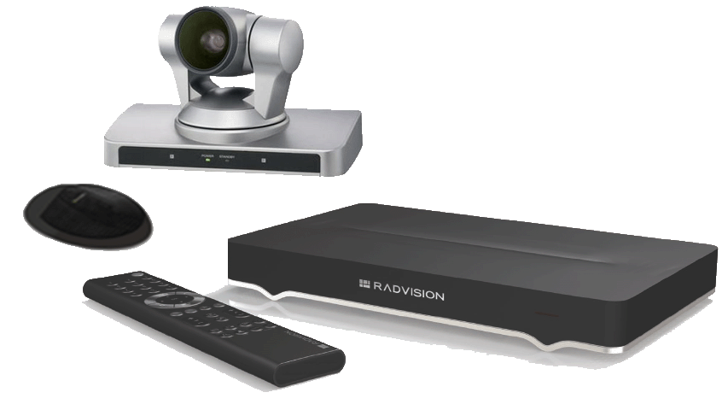
Scopia XT Портфолио Лицензии и Опции
V8.3 FP2
Функции | P/N | цена | XTE 240 | XT4200 | XT4300 | XT5000 | XT7100
Full MCU4 | 55111-00951 | $5,620 | $ | ✗ | $ | $ | $
Full MCU9 | 55111-00952 | $9,350 | ✗ | ✗ | ✗ | $ | $
Full SMB4 | 55111-00941 | $9,165 | $ | ✗ | $ | $ | $
Full SMB9 | 55111-00942 | $14,665 | ✗ | ✗ | ✗ | $ | $
Scopia Control | 55111-00917 | $610 | $ | $ | $ | Включено | Включено
2й LAN | 55111-00916 | $244 | Включено | $ | $ | Включено | Включено
2й экран | 55211-00914 | $3,000 | Включено | Включено | $ | Включено | Включено
Активация 1080p | 55111-00937 | $2,420 | Включено | NA | Включено | Включено | Включено
USB запись | 55111-00933 | $1,210 | $ | $ | $ | Включено | Включено
Набор кодеков (G.728 & G.729A) | 55111-00948 | $122 | $ | $ | $ | $ | $
Notes:
Included for your reference is a chart showing part numbers, pricing and availability of the most popular software licenses and options available for Scopia Executive Desktop and Room systems.
A point of clarification is that the SMB4 and SMB9 features are a combination of the 4 or 9 port embedded MCU along with support for Scopia Desktop and Mobile connectivity – including the clients for up to either 4 or 9 concurrent connected conference participants.

Slide 3
Scopia XT Room System Portfolio
Функция | XTE240 настольная | XT4200 Малые переговорные | XT4300 Малые/Средние перег. | XT5000 Средние/Большие залы | XT7100 Большие залы
Видео | 720p30 1080p30 опция | 720p60 | 1080p60 | 1080p60 | 1080p60
Микрофон | Встроенный 180 град | 1-направл. 3-х напр. Опция | 1-направл. 3-х напр. Опция | 3-х напр. + 2^{й} 3-х напр. Опция | 3-х напр. + 2^{й} 3-х напр. Опция
Опция MCU/SMB | 4@720p30 1080p30 опция | ✗ | 4@1080p30 | 4/9@1080p30 | 4/9@1080p30
Оптич/общий Зум | 1,8 цифровой | 5x 40x optional | 5x 15x optional | 10x/40x | 10x/40x
Поддержка H.265 | ✗ | ✗ | ✗ | ✗ | ✓
HDMI входы | 1 | 1 | 1 | 1 (+3 опция) | 2 (+3 опция)
Запись | Опция | Опция | Опция | ✓ | ✓
Scopia Control | Опция | Опция | Опция | ✓ | ✓
2й LAN | ✓ | Опция | Опция | ✓ | ✓
2й HD Выход (DVI) | ✓ | ✓ | Опция | ✓ | ✓
Notes:
Another reference chart showing the Scopia XT room system portfolio with some key things to point out.
The Scopia XT4200 as the entry level system supports 720p capability, while the new XT4300 offers 1080p resolution.
Both the XT5000 and XT7100 include meeting recording to a USB drive or stick, Scopia Control which delivers advanced meeting control through an Apple iPad, and dual display support as standard.
The XT4300, XT5000, and XT7100 all offer optional embedded MCU capabilities to host multi-party calls.
And to wrap this slide up, the XT7100 is the only system to offer the H.265 video codec.

